Slide 1
MedNet – A Social Media for Medical Help

Slide 2

Introduction – What is MedNet about?
This project is an effort to create a social media for medical help – MedNet, for citizens to create medical profiles, form connections, and centralize their medical history.
Aim: To provide a centralized location for all authorized medical services and medical records.

Slide 3
Goals
Create a medical network
Provide feature rich mobile enabled web platform.
Organize data in a sophisticated RDBMS schema to provide fast, secure, and stable retrieval of information.
Allow the Government to monitor the medical conditions and analyze disease trends.
Connect with other users of the system.
A veritable goldmine of health data.

Slide 4
Medical Services
Authorized Medical Certificates
Organ Donation
Surrogacy
Fund Allocation
Sperm Donation
Blood Donation

Slide 5
Benefits
Centralized Digital Medical Records
Easy access
Share
Hospital Appointments
Book
Track
Endorse Medical Services
Hospitals
Doctors
Become a Donor
Organ
Fund
Request Medical Help
From other users
From Governement

Slide 6
System Actors
Healthcare Accreditation Authority
Manages the registration approval of all the users of this system.
Doctor
Uses the system as a platform for endorsing medical services.
Abides by the medical guidelines as specified by the accreditation authority.
Verifies the authenticity of the user in specified time.
Hospital
Civilian
Approved by the accreditation authority to provide medical services to civilians on request.
Houses various registered Doctors.
Uses the system to seek medical help.
Central entity of this system.
Can volunteer for donations including blood donation, organ donation, fund donation.

Slide 7
System Actors (cont.)
Authorized to use non personalized data of all other users, for health care analysis.
Volunteer Organization
Offers large scale medical help.
Empowers the healthcare accreditation authority.
Registered User
Unregistered User
Takes part in seeking or providing medical services through the system.
Must be approved by Accreditation Authority.
Empowers other users on the system.
Has access to non-personalized data of the system for doing analysis or detecting hoax information provided by registered users on the system.
Government
Follows the guidelines specified by the accreditation authority.

Slide 8
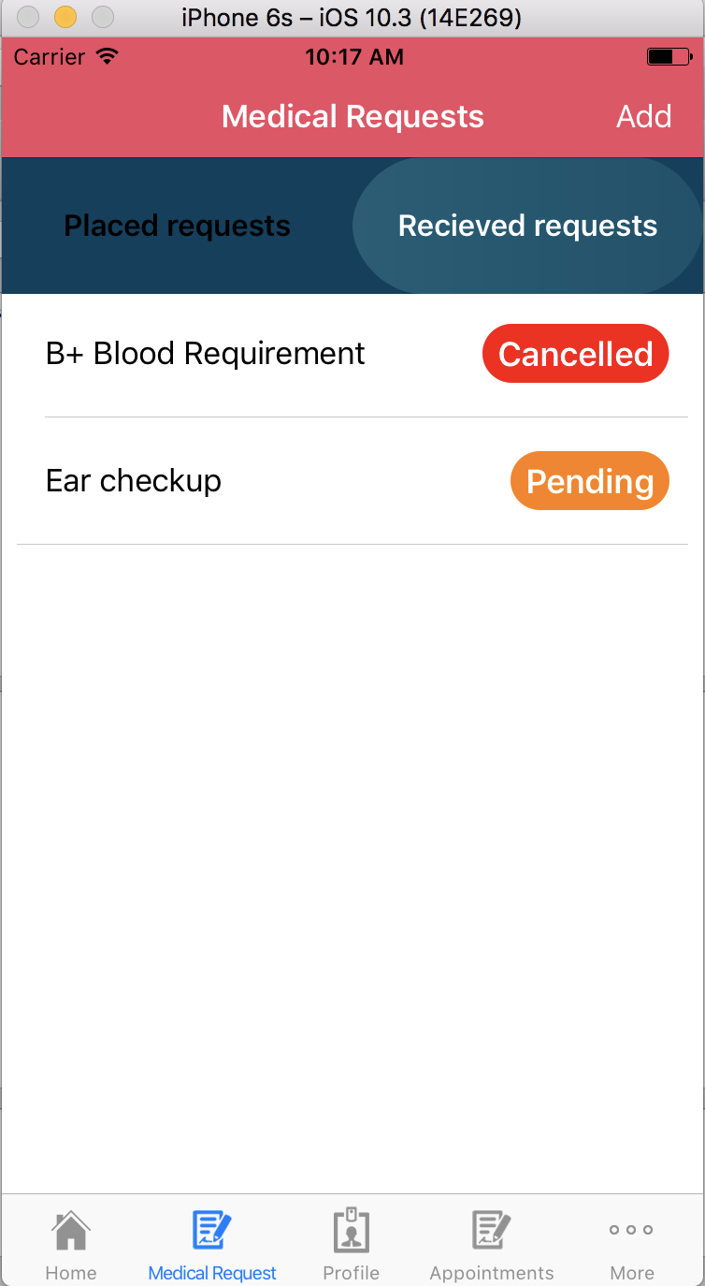
Request Medical Help - Use case

Slide 9
View Medical Profile - Use case

Slide 10
Become a Donor - Use case

Slide 11
Demo

Slide 12
Future Enhancements
Get detailed reports of diseases based on age groups, demographic location and lifestyle habits.
Early detection of diseases based on the year summary medical reports of state or city.
Monitoring health rate and disease trends among certain group like state or country.
Authorized and Secure fund transfers for donations.

Slide 13
References
Celis, S. (2017, Mar 30). SQLite.swift. Retrieved from https://github.com/stephencelis/SQLite.swift
Chavely, P. and Dixit, P. (2015, Jun 7). Aadhar MedNet. Retrieved from https://www.youtube.com/watch?v=2sDQ-P5SEnc
Wagner, C. (2016, Mar 3). SQLite Tutorial: Getting Started. Retrieved from https://www.raywenderlich.com/123579/sqlite-tutorial-swift

Slide 14


